Slide 1

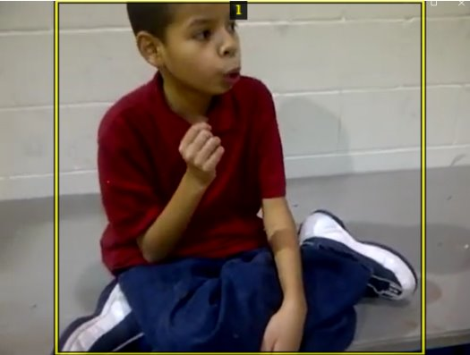
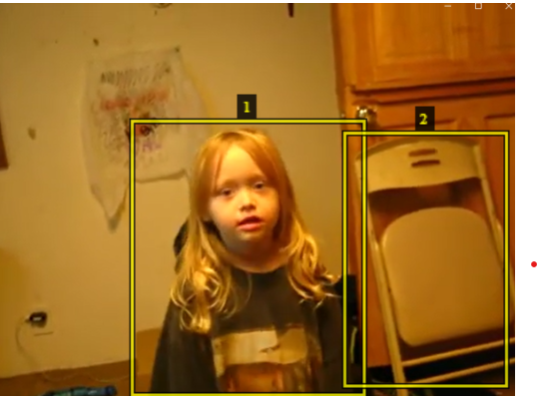
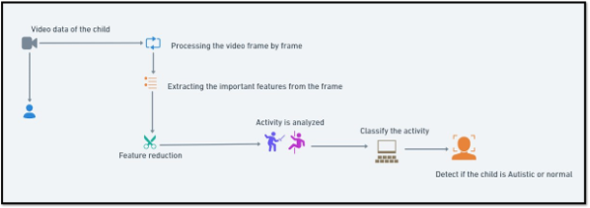
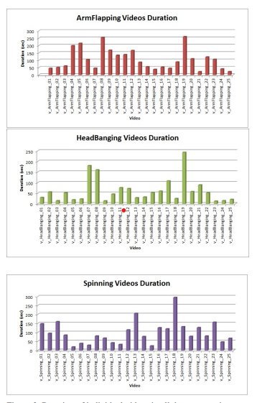
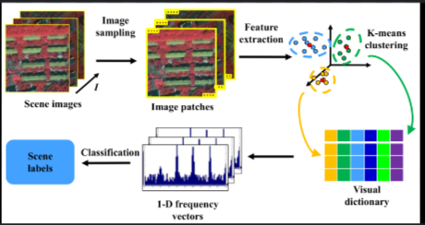
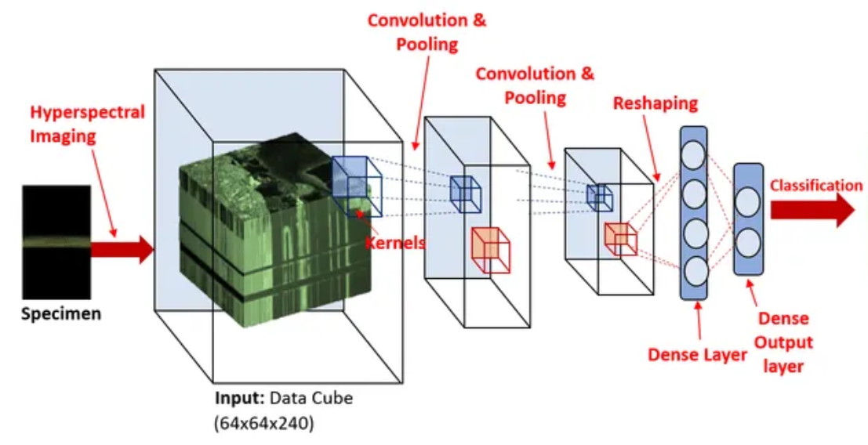
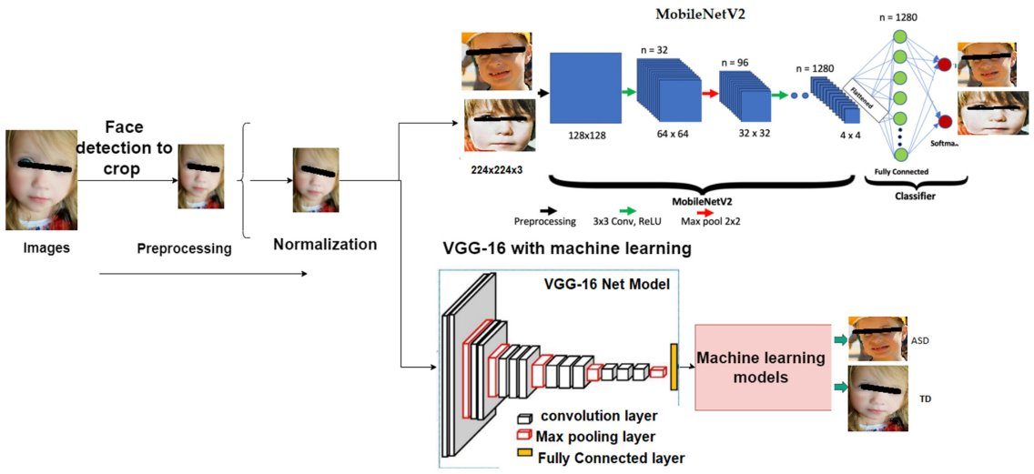
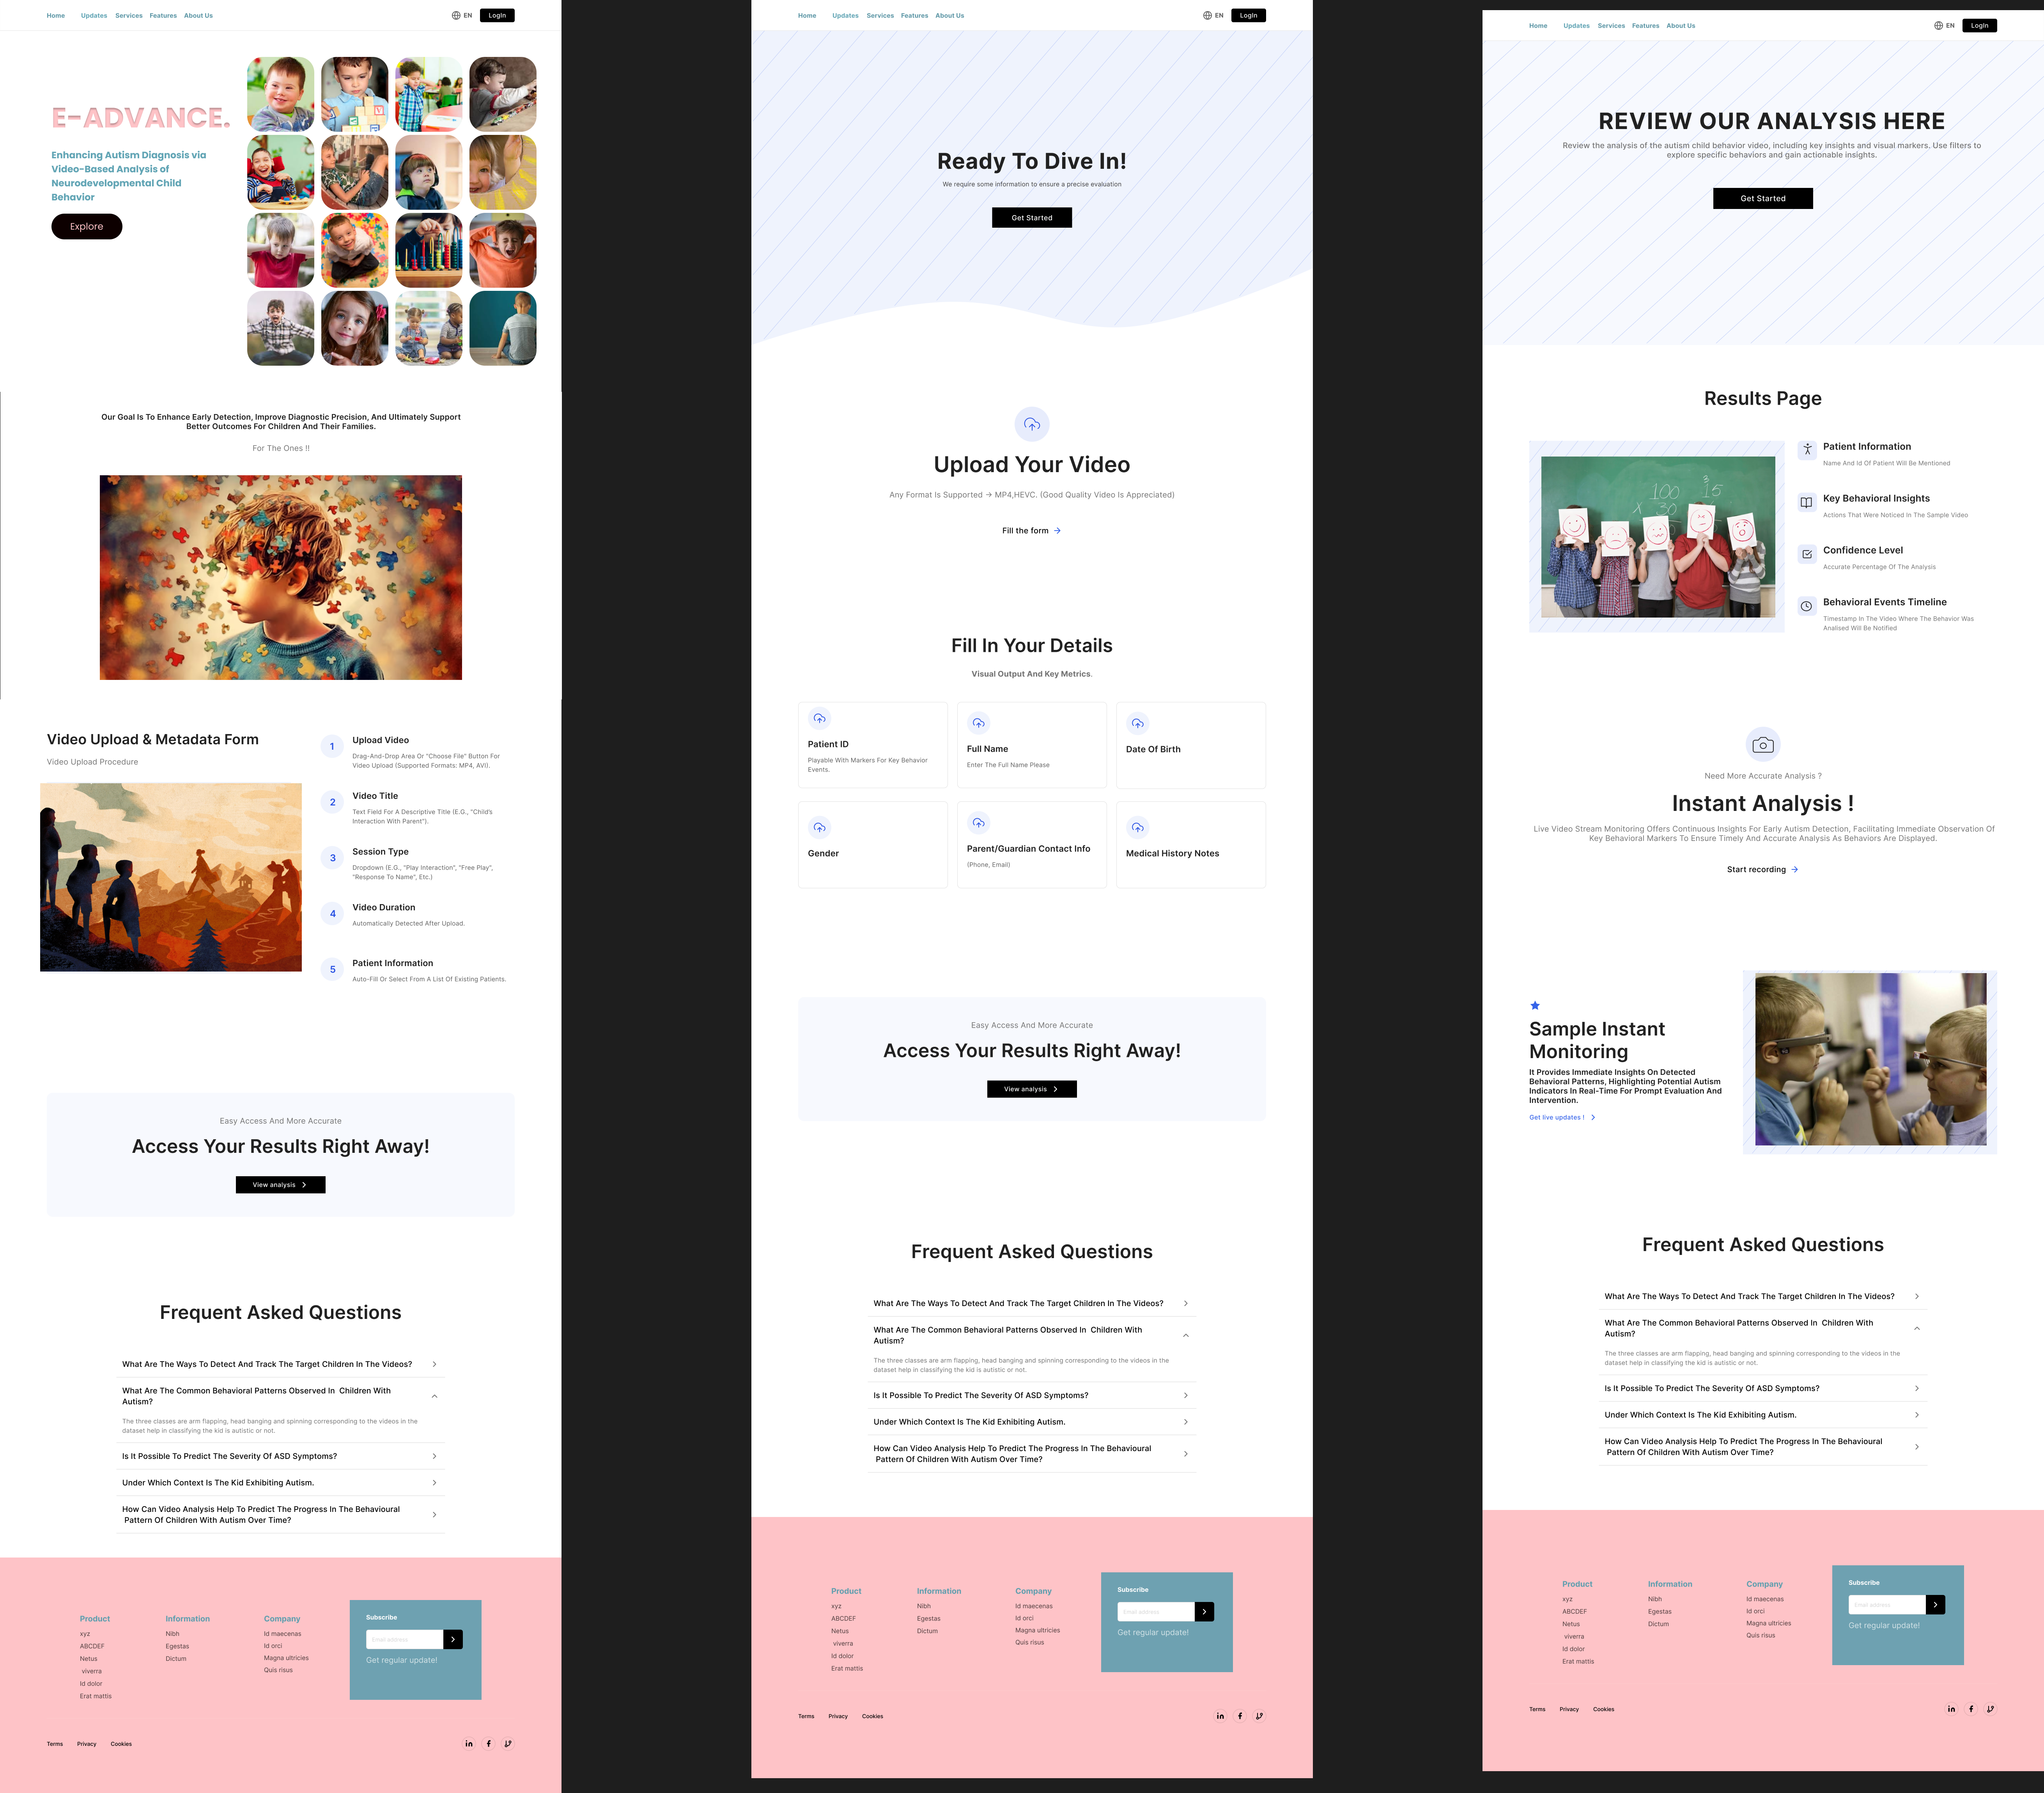
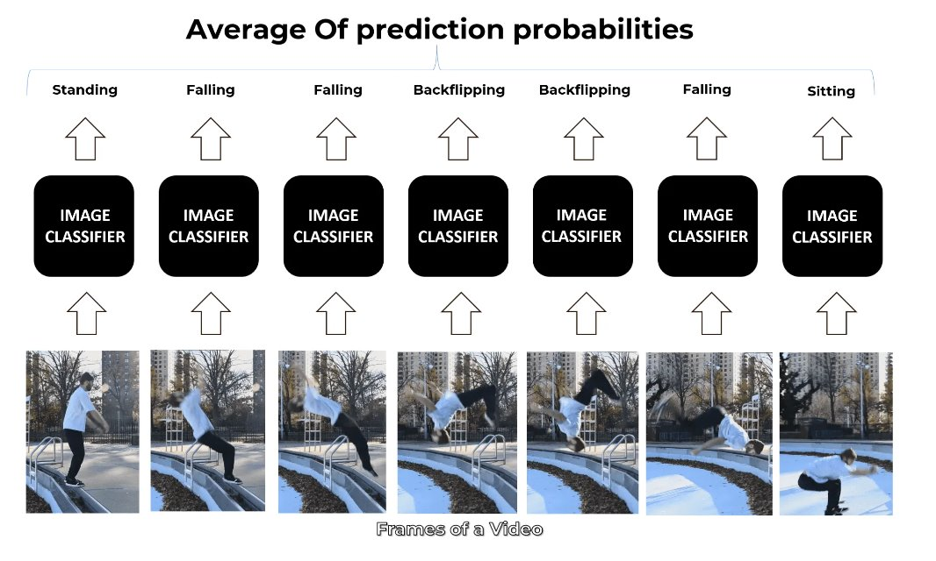
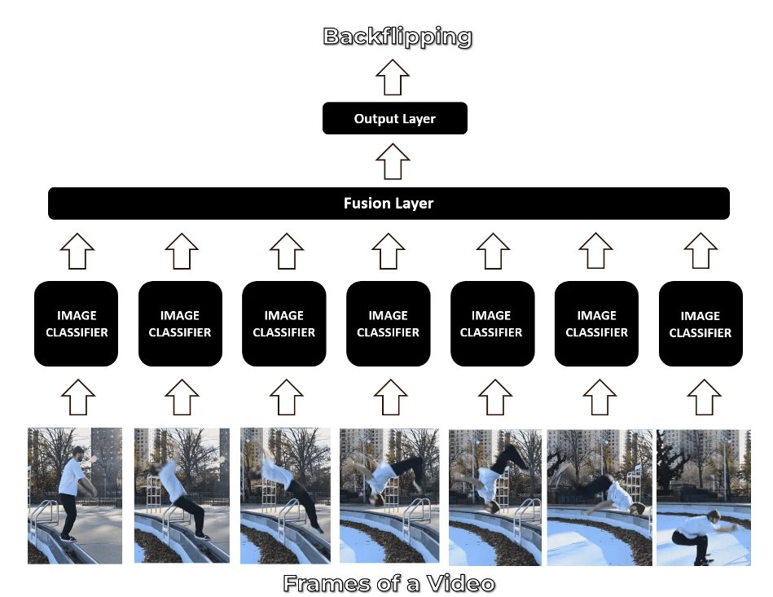
Enhancing Autism Diagnosis via Video-Based Analysis
of Neurodevelopmental Child Behavior
Abineha P, Naveen Raaghavendran, Sri vaishnavi JV
(A) GOAL & CONTRIBUTIONS
(E) Annotation Tool – VGG Image Annotator (VIA)
Develop an automated system for detecting and analyzing self-stimulatory behaviors in children with Autism Spectrum Disorder (ASD) through the analysis of video footage.
The system understands the patterns of behaviors such as arm flapping, head banging, and spinning and provides the doctors with a detailed behavior analysis of patients.
Utilize pose estimation algorithms and motion analysis techniques to extract relevant features from the video frames.
The three classes are arm flapping, head banging and spinning corresponding to the videos in the dataset
(B) Project Workflow
Image Annotation: Allows users to manually annotate objects, regions, or points of interest in an image. It supports bounding boxes, polygons, and other shapes.
Exporting Annotations: Annotations can be saved in JSON or CSV formats, which are compatible with various machine learning frameworks.
(F) Dataset Details
Attributes | Description
URL | Reference website URL to the video
Persons | Number of persons in the video
Behaviors | Number of stimming behaviors in the video
Time | The behaviour start-end time instant in a video
Body Part | Hand, Head, Face, Eye, Full
Category | Stimming behaviour category
Intensity | Behaviour Intensity - Low, Medium and High
Modality | Dominant behaviour modality like audio, video - for future use
The input image from the dashcam is given to the program which is linked to the cloud. The program will identify the lanes, objects and activities. Then tracking and mapping will be done. Upon which the percentage chance of collision is calculated using Deep learning.
(C) Model Architecture Diagram
For achieving the end goal 3 models are chosen:
1) Bag of Visual Words 2) 3D CNN 3) LSTM + CNN
2)
S. No | Data-set name | No of Files | Resolution | Environment | Color | Image/Video Format
1 | SSBD | 58 | 1920 x 1080 | Indoor and outdoor | RGB | .mp4
(G) Product design
3)
(D)Activity Detection
Extract Frames: Split the video into individual frames at a specific frame rate using tools like OpenCV.
Preprocess Frames: Resize and normalize frames to a standard size for consistency.
Feature Extraction: Extract relevant features from each frame, using methods like CNNs or pose estimation.
Sequence Modelling: Use temporal models like LSTMs, 3D CNNs, or Transformers to capture the sequence of frame features.
Classification: Classify the sequence of frames into activity classes (e.g., arm flapping, head banging, spinning).
Post-Processing: Apply smoothing techniques to filter out misclassifications and maintain temporal coherence.
Evaluation: Measure model performance using accuracy, precision, recall, and F1-score.
Deployment: Implement the trained model in real-time or batch processing for activity recognition.
References
Abid Ali, Farhood F Negin, Francois F Bremond, Susanne Thümmler. Video-based Behavior Understanding of Children for Objective Diagnosis of Autism. VISAPP 2022 - 17th International Conference on Computer Vision Theory and Applications, Feb 2022, Online, France. ⟨hal-03447060⟩
S. S. Rajagopalan, A. Dhall and R. Goecke, "Self-Stimulatory behaviors in the Wild for Autism Diagnosis," 2013 IEEE International Conference on Computer Vision Workshops, Sydney, NSW, Australia, 2013, pp. 755-761, doi: 10.1109/ICCVW.2013.103.

